Slide 1
MIGRATION AND ITS EFFECTS
Migration plays a very key role in our economy as it deals with our work force, foreign currency inflow etc.

Slide 2
TYPES OF MIGRATION
Internal migration :
i) This is basically migration within the country
ii)It is of two types , viz., intra state migration and interstate migration.
External migration :
It is migration from your host country to another country abroad.

Slide 3
Causes

Slide 4
A BRIEF
Migration in India is primarily of two types:
Long-term migration, resulting in the relocation of an individual or household;
Short-term or seasonal/ circular migration, involving back and forth movement between a source and destination.
Most short-term migrants belong to socioeconomically deprived groups, such as Scheduled Castes or Scheduled Tribes
They having negligible educational attainment, limited assets and resource deficits

Slide 5
RURAL TO CITY MIGRATION CAUSES
Village economy is dependent on agriculture so people without agricultural land migrate
Education and job is another reason for migration.
Poor returns from the subsistence agriculture and agricultural distress
They don't have basic facilities that are needed for daily life practices such as water , electricity and transportation.
The social restrictions in employment like the caste system also make people resort to migrate to cities where they can work freely under the urban anonymity.

Slide 6
Bordering countries to India migration causes
India being a democratic country and having liberal policies
Acceptance of refugee’s to support them from war or terrorist attack conditions
For education and business purposes

Slide 7
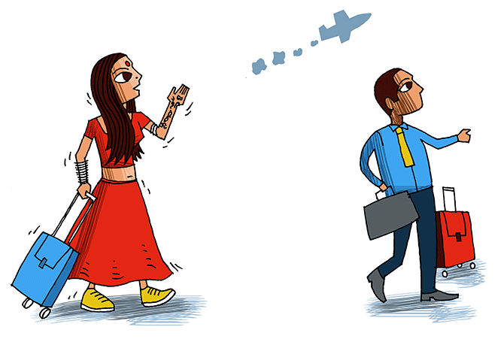
India to abroad migration
Better salary and facilities
Pursuing for further education
For research purposes
Growing sentiment of working abroad particularly US

Slide 8
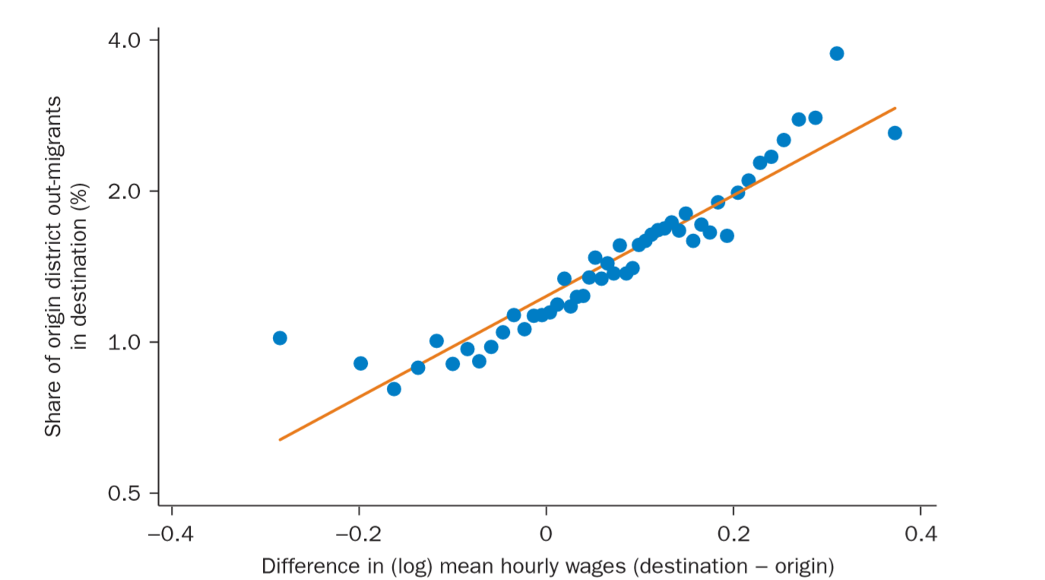
An increase of 11 percent in mean hourly wages in a district makes an Indian internal migrant 10 percent more likely to migrate to that district.

Slide 9
SOME OTHER FACTORS THAT CAUSE MIGRATION
Lack of security
- Political disturbances and interethnic conflicts drive people away from their homes
- Example of this type of migration in India can be seen in Jammu and Kashmir and Assam. Large number of people migrated out during the last few years due to disturbed conditions there.
Forced Migration
Residents of a particular area are rehabilitated due to unsafe living conditions or due to building of dams or natural calamities.
Marriage
It is a very important social factor of migration.

Slide 10
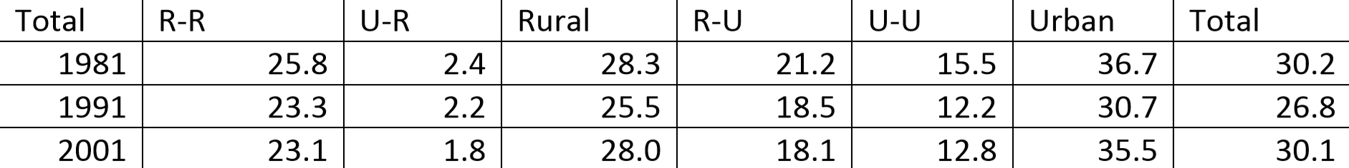
Marriage accounts for 71 percent of all female migration in India. Men have more varied reasons: about 30 percent migrate for work, and a similar number migrate with their families. Over 70 percent of marriage migration is over a short distance and takes place within a district.

Slide 11
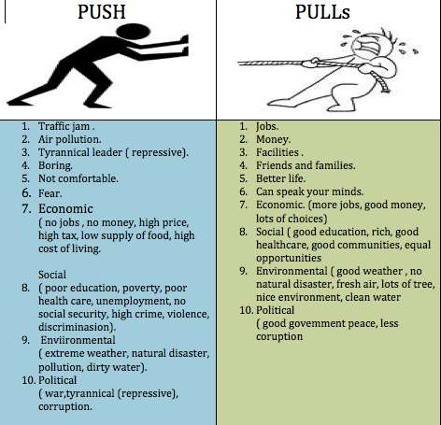
PUSH AND PULL FACTORS

Slide 12
ABOUT INDIA’s POLICIES ON MIGRATION AND STATS

Slide 13
A BRIEF ON MIGRATION HISTORY OF INDIA-I
The Economic Survey of India 2017 estimated that the magnitude of inter-state migration in India was close to 9 million annually between 2011 and 2016
While Census 2011 pegs the total number of internal migrants in the country (accounting for inter- and intra-state movement) at a staggering 139 million.

Slide 14
A BRIEF ON MIGRATION HISTORY OF INDIA-II
In 2017, India was the largest country of origin of international migrants (17 million), followed by Mexico (13 million). Other countries of origin with large migrant populations include the Russian Federation (11 million), China (10 million), Bangladesh (7 million), Syrian Arab Republic (7 million) and Pakistan and Ukraine (6 million each).
Lead source states: Uttar Pradesh, Bihar, Rajasthan, Madhya Pradesh, Andhra Pradesh , Chhattisgarh, Jharkhand, Orissa, Uttarakhand and Tamil Nadu. Key destination states: Delhi, Maharashtra , Gujarat, Haryana, Punjab and Karnataka.

Slide 15
A BRIEF ON MIGRATION HISTORY OF INDIA-III
Internal migrants in India constitute a large population: 309 million internal migrants or 30 percent of the population (Census of India 2001), and between 2007 to 2008 these estimates reached 326 million or 28.5 percent of the population (NSSO 2007–2008).

Slide 16
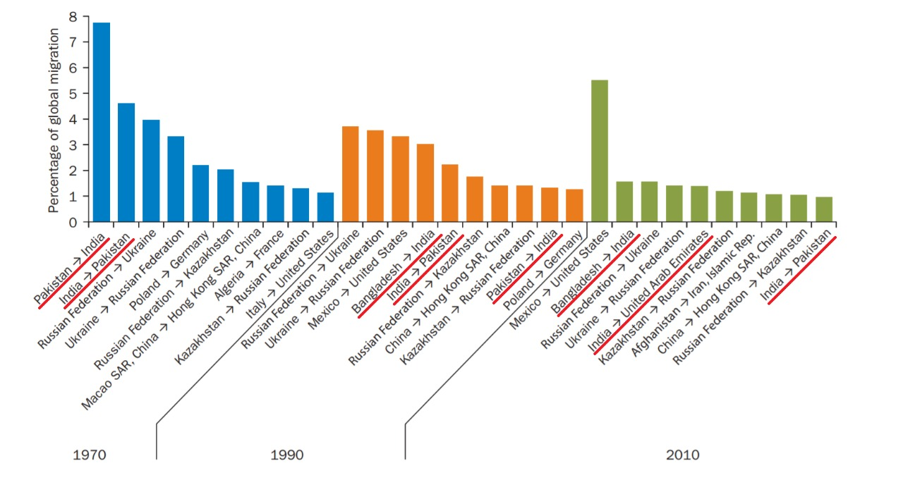

Slide 17
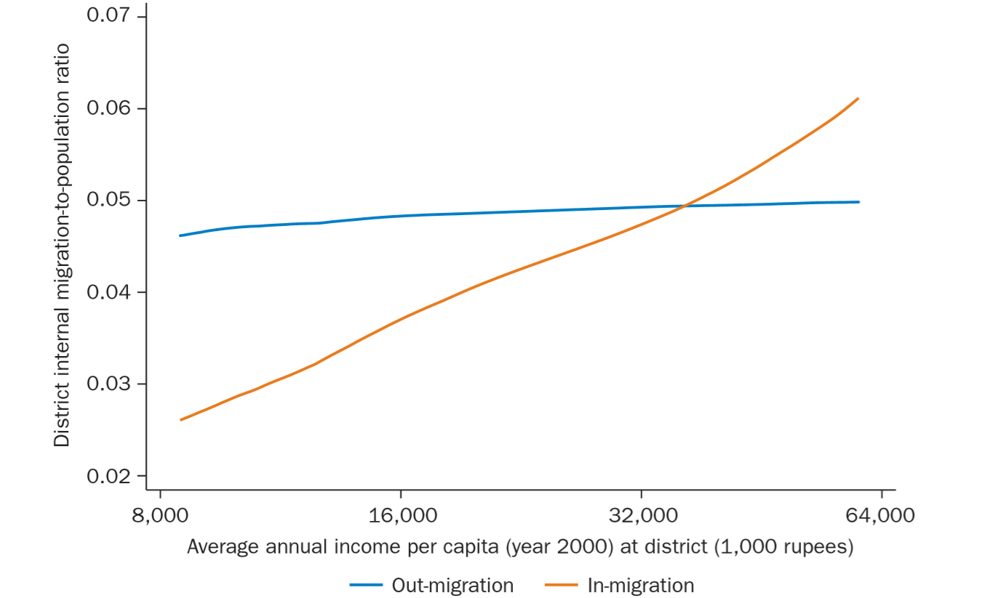

Slide 18
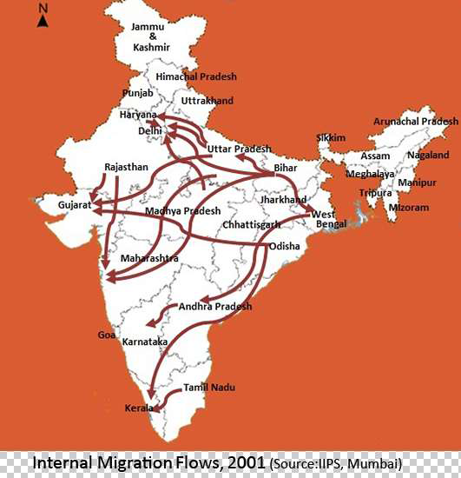
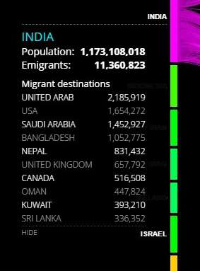

Slide 19
NATIONAL RURAL EMPLOYMENT GUARANTEE ACT,2005

Slide 20
National Rural Employment Guarantee Act, 2005-I
Later renamed as Mahatma Gandhi NREGA, it is an Indian labor law and social security measure, that aims to ensure livelihood security in rural areas by providing at least 100 days of wage employment in a financial year to every household whose adult members volunteer to do unskilled manual work.
It is implemented mainly by Gram Panchayats. Labor intensive tasks like creating infrastructure for water harvesting, drought relief and flood control are preferred.

Slide 21
National Rural Employment Guarantee Act, 2005-iI
NREGA helps in protecting the environment, empowering rural women, reducing rural-urban migration and fostering social equity.
However, amendments have been proposed in 2014, towards increasing the minimum wage to Rs. 300, ensuring employment to all card holders of a family and to involve the Gram Sabha in the implementation of this policy.

Slide 22
EFFECTS OF MIGRATION

Slide 23
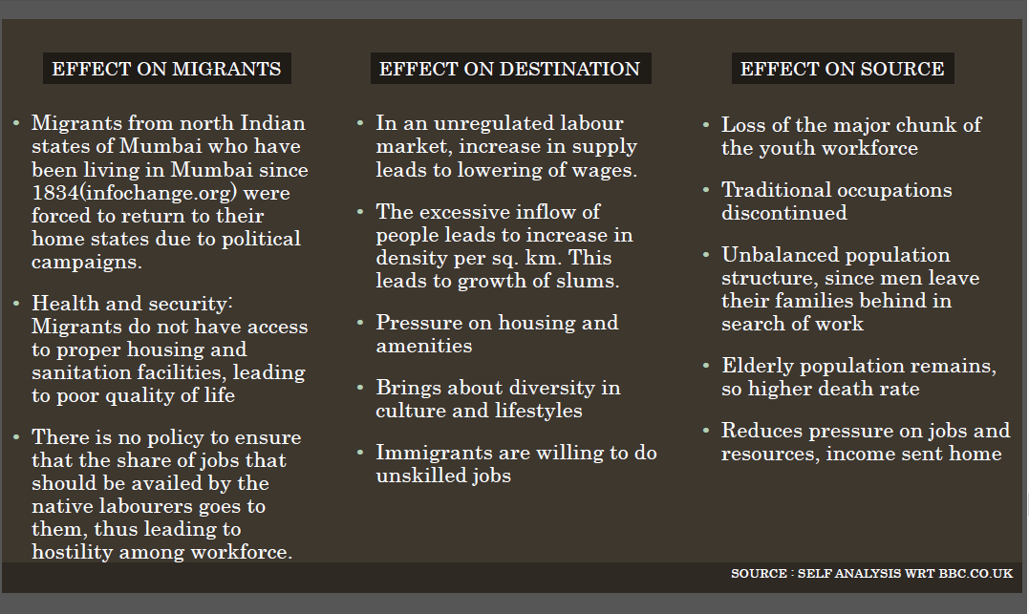

Slide 24
POSITIVE Effects OF migration
The positive economic gains from immigration are largely the result of the infusion of inexpensive and eager laborers into the economy.
Literacy rate increases(increase of 9.2 percent between 2001 to 2011)
Migration affects the occupational structure of population.

Slide 25
NEGATIVE EFFECTS OF MIGRATION
Seasonal migrants dominate the low-paying, hazardous and informal market jobs in key sectors in urban destinations, such as construction, hotel, textile, manufacturing, transportation, services, domestic work etc
They have poor access to health services, which results in very poor occupational health.
Migration also causes brain drain.

Slide 26
Migration changes the resource- population ratio
Migration changes the resource- population ratio. If the people are moving from an over populated area to an area of under population the result is in the balancing of the resource- population ratio.
If the migration is from an area of under population to over population or optimal populated, the results are harmful to both the areas. Migration affects the occupational structure of population

Slide 27
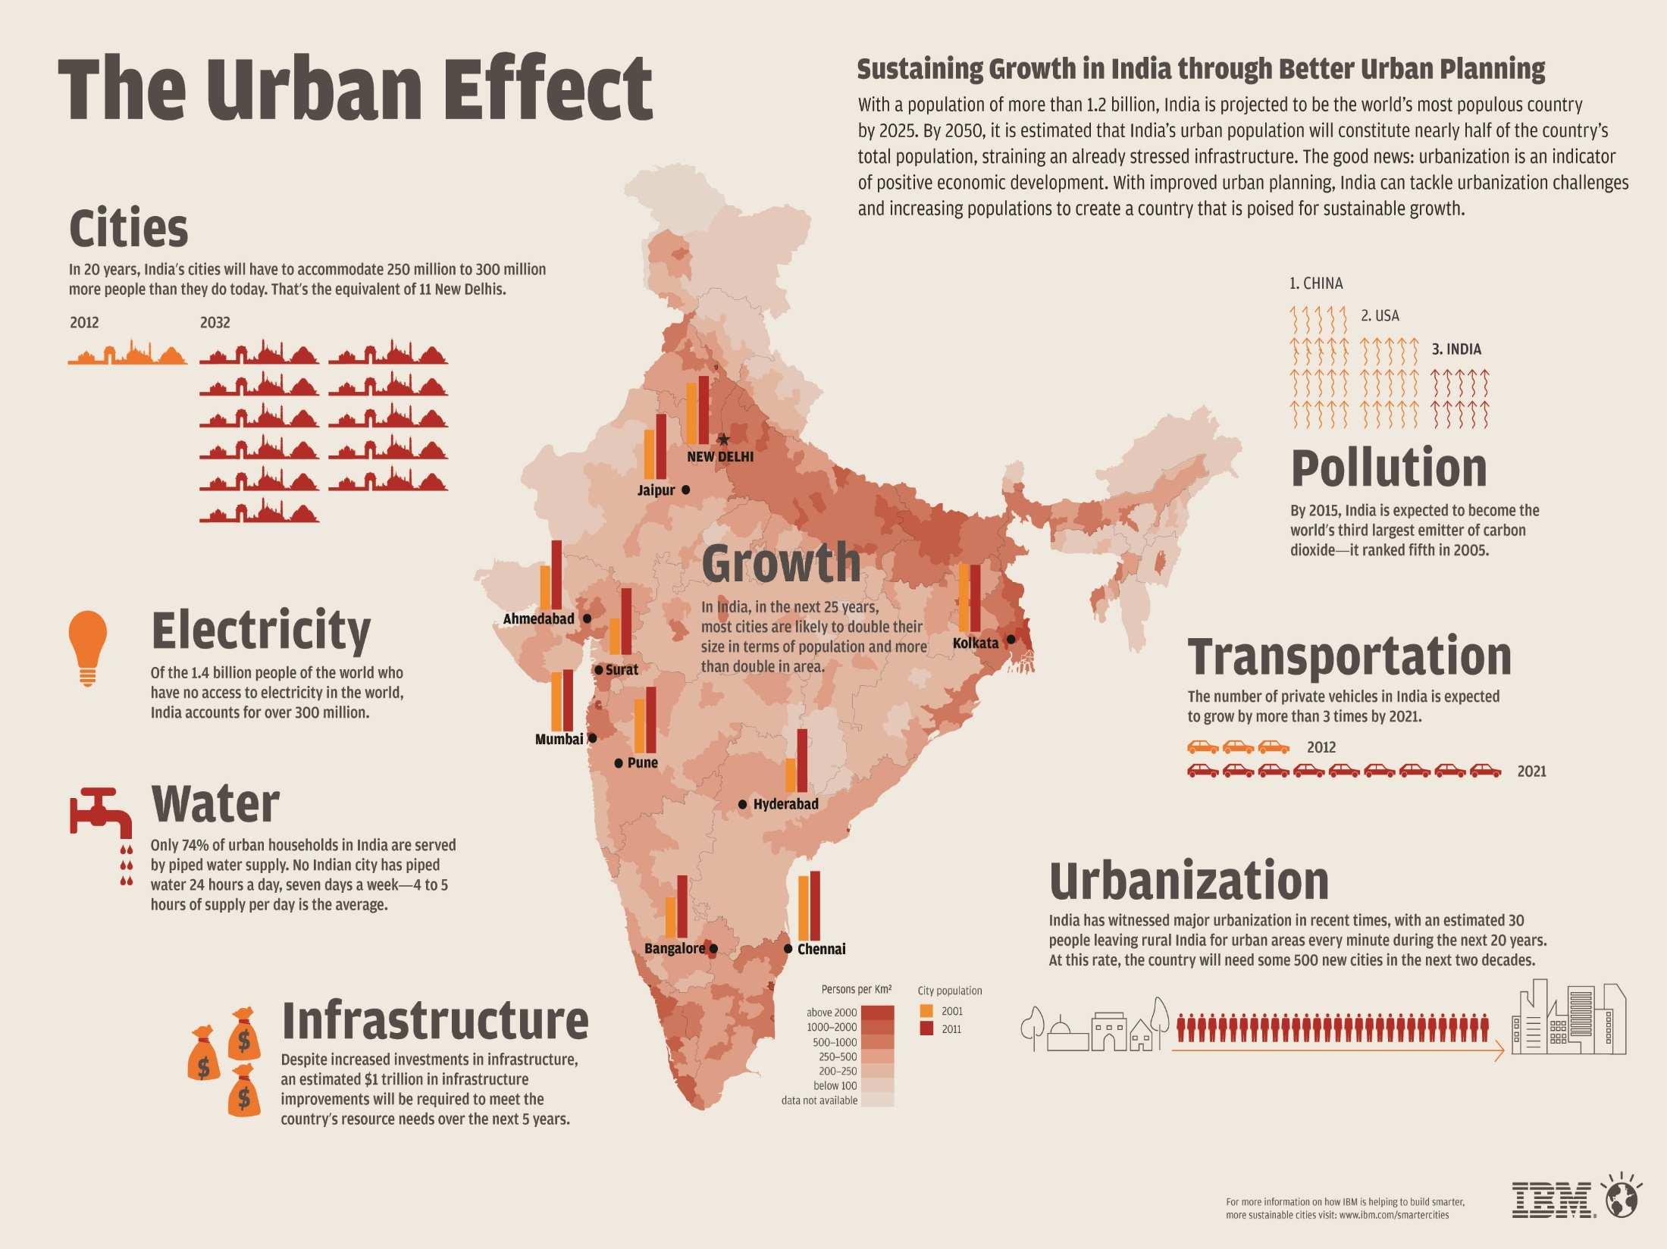

Slide 28
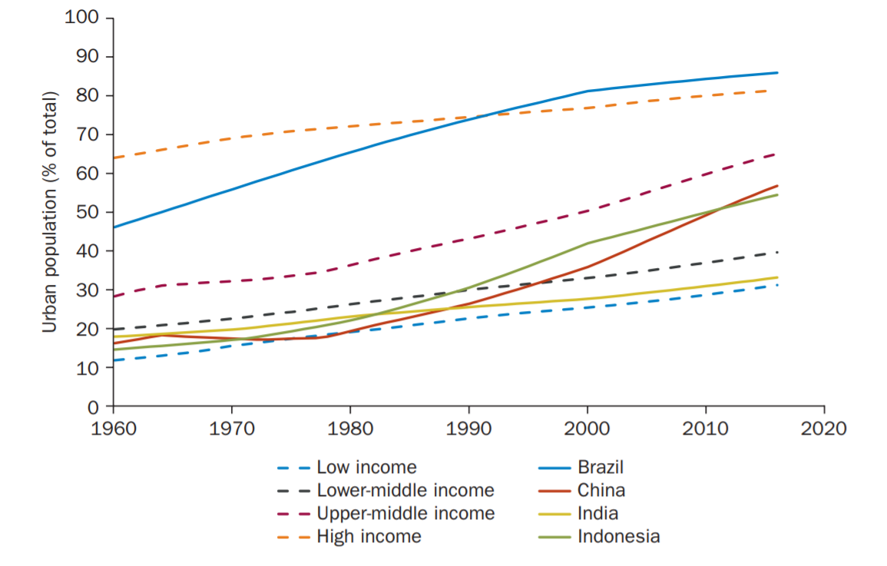
Rise in Urbanization

Slide 29
Foreign currency Inflow
People migrating from India to abroad bring in the most foreign currency.
Reduction in remittance from abroad.
Saudi Arabia and UAE being the highest remittance sender
However remittance from abroad is reducing by 6.5 per cent in 2016- 17. (due to fall in crude prices)
Tightening in foreign labor laws

Slide 30
CASE STUDY ON EFFECTS OF RURAL TO URBAN MIGRATION
Case study outlining the effects of rural to urban migration on rural areas and small town's among Calcutta
Destination: Calcutta's Bustees (Shanty Towns).

Slide 31
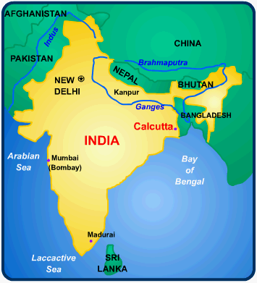
REASONS
Large population growth in rural areas puts more pressure on the environment.
Wages in Calcutta are approximately six times that of rural areas.
Sub-division of land passed on makes a subsistence life more difficult and reduces the assets against which a rural inhabitant could get a loan.
A chance to escape the rigid caste system that is still very strong in rural areas.

Slide 32
Consequences for area they arrive in - I
These are massive and one of the biggest problems facing the entire developing world. In Calcutta they include:
Higher rates of infant mortality than towns.
Half a million people sleeping on the streets.
Increased air pollution as the pressures of population create a need for more industry. In addition, people use wood and charcoal for cooking.

Slide 33
Consequences for area they arrive in - II
The old water system cannot cope. Leaking pipes allow contamination to enter the water supply. In Monsoon season, this is particularly bad as sewage infects the water.
Increased traffic causes greater air pollution problems. As many as 60% of the population suffer from breathing problems.
Bustees have to occupy the least desirable land. This is often prone to flooding particularly during monsoon season but also is likely to be located near industry increasing problems with air pollution but also experiencing toxic chemical discharge.
Alternatively the developments could be on steep slopes increasing the chances of landslides.

Slide 34
Consequences for area they leave - I
If the migrant finds work in the city then it is likely that the village he left will benefit from money sent home. This is what every migrant dreams of but the situation in reality is usually very different.
As the pressures of urbanization increase so government expenditure on urban areas must increase this leaves the rural areas facing an ever more difficult situation.
Lack of investment on health and welfare will have obvious effects for those left behind.

Slide 35
Consequences for area they leave - II
It is the young motivated male that is most likely to leave. This has implications for those left behind. There will be a predominantly elderly population that will find it ever more difficult to support themselves.
Whilst migration may ease some of the population pressures, the high birth rates in rural areas means that situation is deteriorating. This means a constant loss through migration with the break up of families.

Slide 36
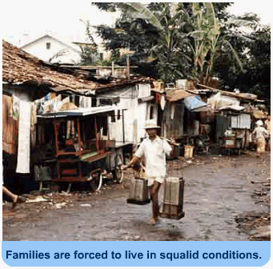
Consequences for the migrant:
Forced to live in squalid conditions in the bustees.
Often the only work available would be in the informal sector. Jobs here can include rummaging amongst rubbish tips to find materials that can be sold for re-cycling.
Often feel forced to stay in the cities not wanting to face the failure of going home.

Slide 37
BIBLIOGRAPHY
Moving for Prosperity: Global Migration and Labor Markets(World Bank)
BBC
IBM Smarter Cities India - The Urban Effect Infographic
Census of India

Slide 38
Conclusion
Migration occurs due to the socio economic circumstances. They might or might not be fruitful but in case they can neither be said to be bad or good. It all depends on the situation however even in bad conditions the countries laws are the ones that can protect their own citizens at the same time show some humanity to the people not our own.

